Slide 1

Introduction
Knowhere
(team:TNcpl-165)
Team members:
1.Nishaanth S
2.K.Tirumala rao

Slide 2
Problem Description:
Build a tool that automatically translates existing educational materials (textbooks, research papers, online courses) into multiple vernacular languages, maintaining accuracy and context, to widen access to knowledge.
solution:
Education is essential for everyone, but language barriers can make learning difficult. Our project uses Knowhere to translate educational materials into different languages. Students can access materials in languages they understand, breaking down barriers to education. This makes learning accessible to everyone, regardless of their native language. With Knowhere, everyone can learn, grow, and succeed.

Slide 3
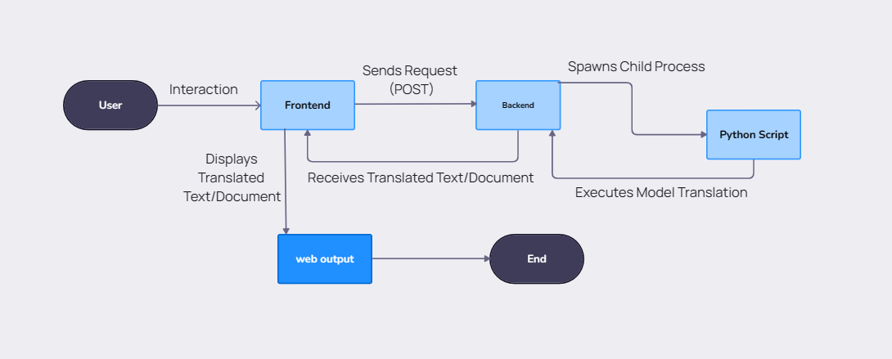
Approach:

Slide 4
Technical feasibility:
Node.js-Python Integration
Language Translation Model
File Format Handling
Performance and Scalability
Compatibility
Error Handling
Practical Feasibility:
Resource Availability
Ease of Deployment
Cost-Effective Technologies
Scalability Options
Maintenance Simplicity

Slide 5
Benefits:
Improved Communication
Streamlined Translation
Cost Savings
Time Efficiency
Increased Accessibility

Slide 6

Demo of Knowhere:

Slide 7
Thank You

